Slide 1
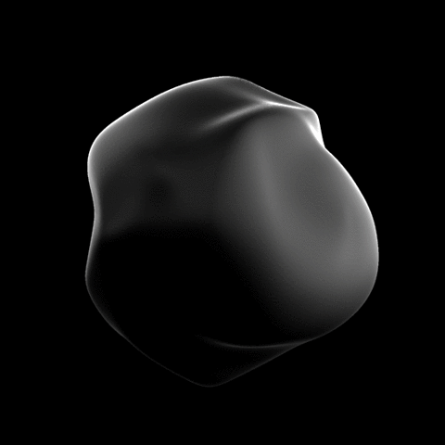
ZeLab
Your Everyday Calculator
And beyond

Slide 2
ZeLab- Problem Statement
Simple calculators are everywhere but a calculator that does the job that every calculator does, but also has culpability of solving other problems such as trigonometry, geometry, physics of projectiles etc… , would be much helpful to students, researchers and scientific community.

Slide 3
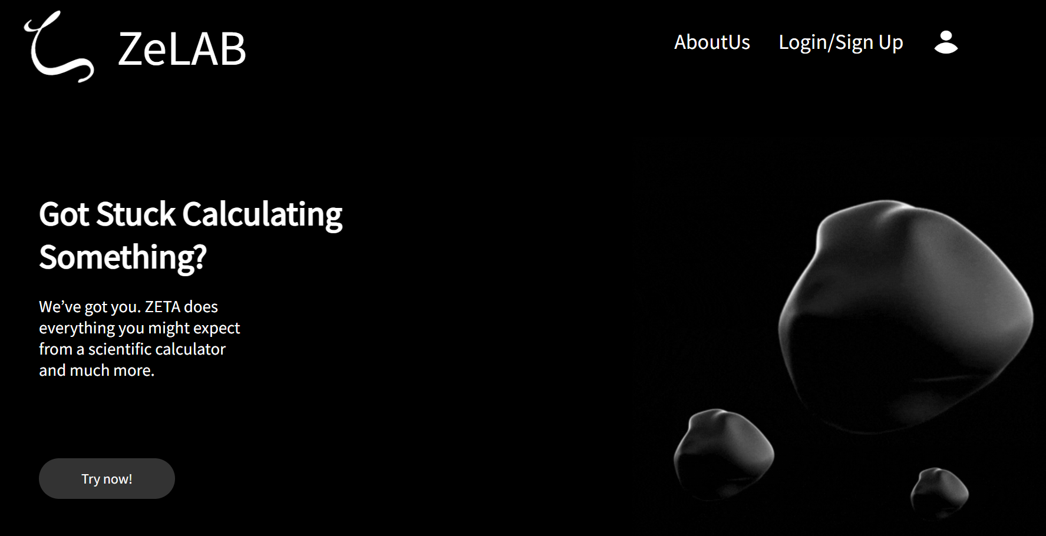
Modern minimalist UI

Slide 4
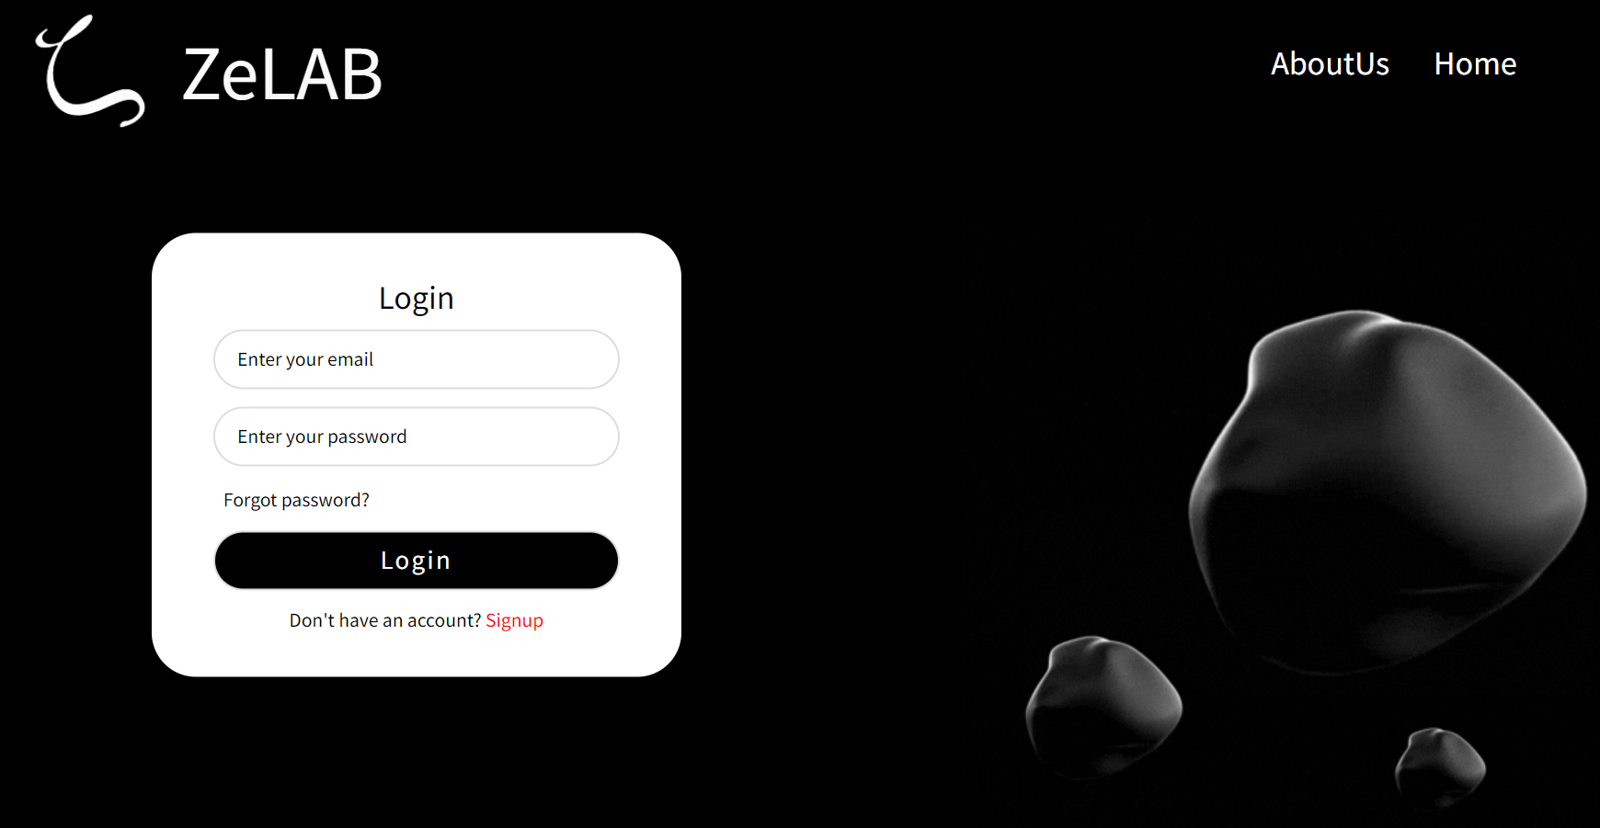
Sign-up/Sign-in

Slide 5
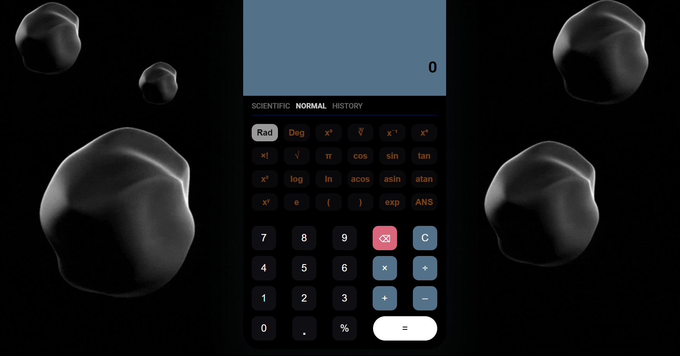
Simple Calculator

Slide 6
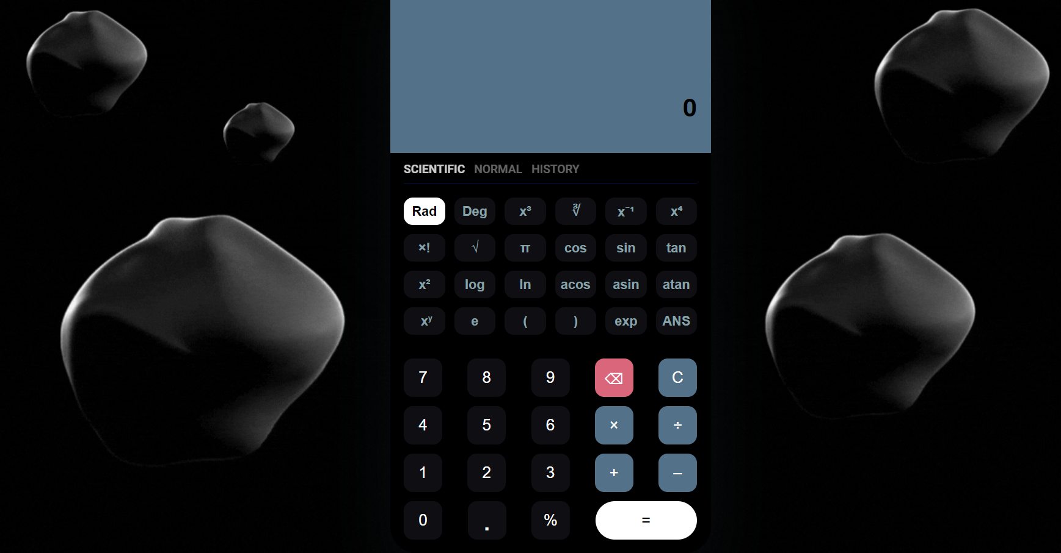
Scientific Calculator

Slide 7
Future scope
Due to its modular design any additional functionality could be added just as easily and that would help in collaboration by other developers that want to add other functionality to make the platform more robust and multidimensional.

Slide 8
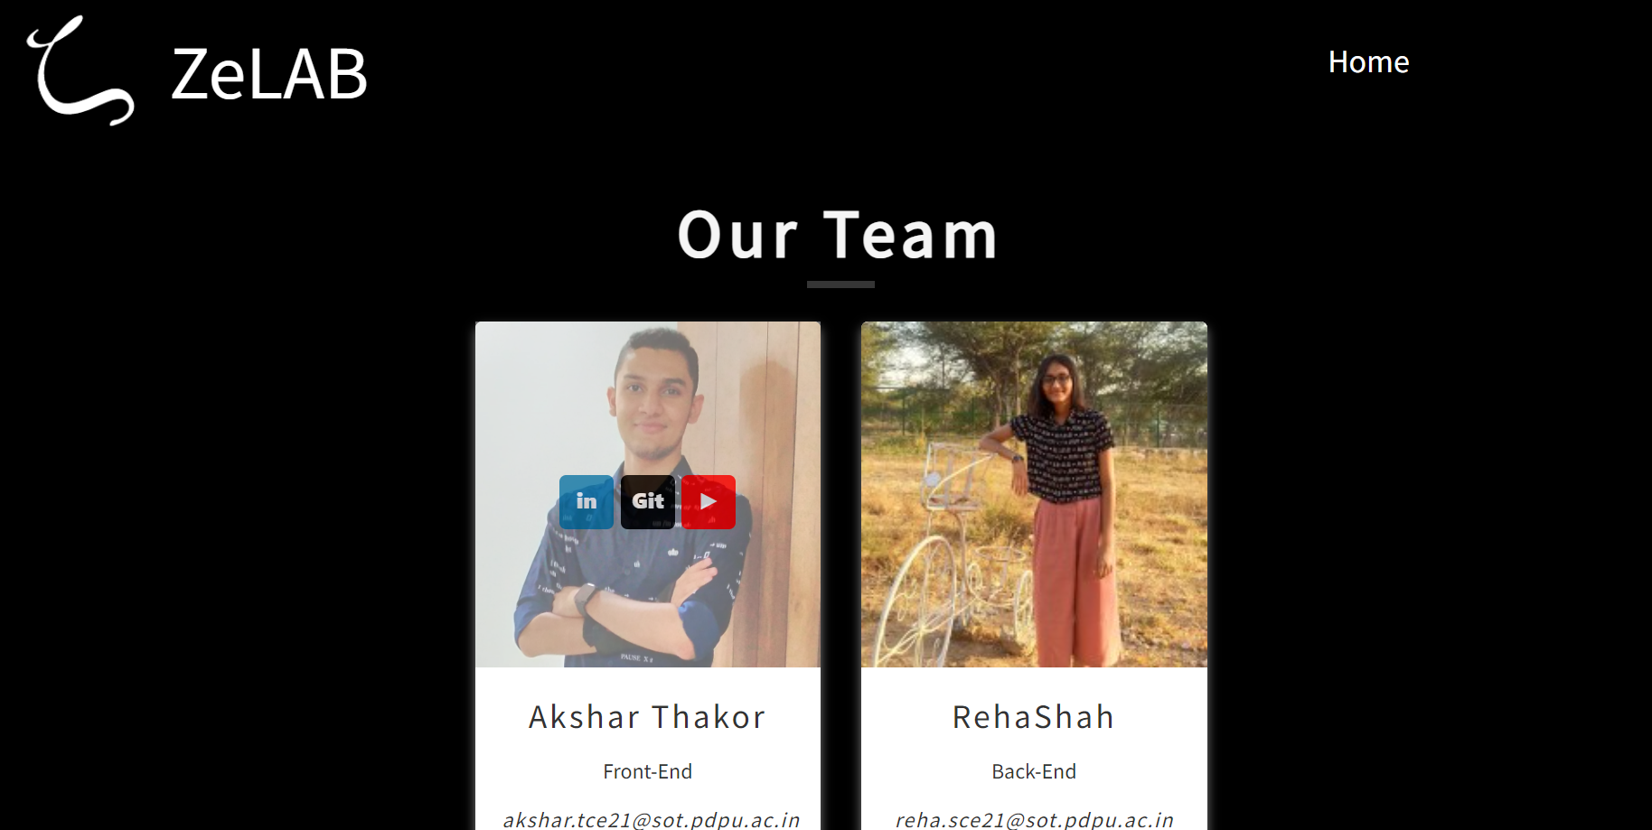
Our team

Slide 9
Thank you

